Slide 1
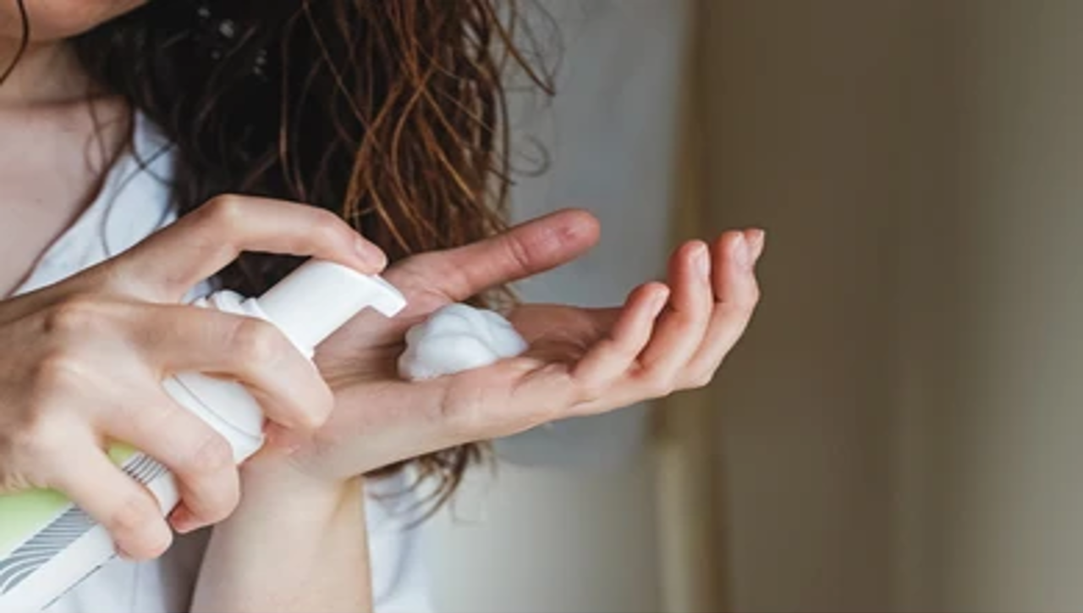
Hair Mousses USA – 36 Mn. USD UAE – 0.4 Mn. USD (~1.4 Mil AED)

Slide 2
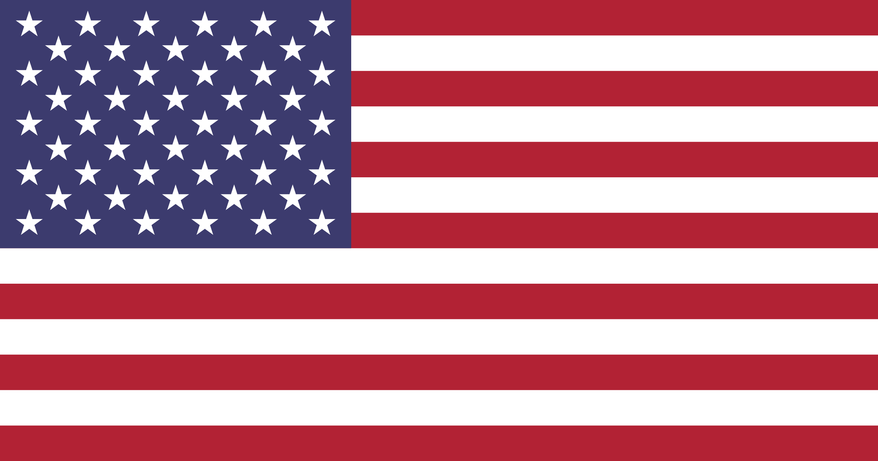

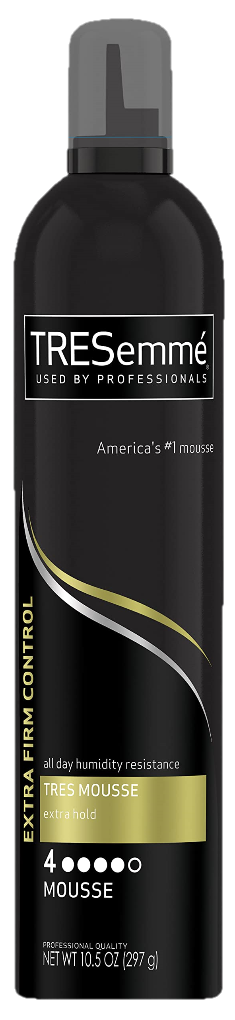
Hair Mousses
Overview
Parameter | USA | UAE
Weight | 175-240 ml (~Oz. 8-10) | 175-240 ml
Price Range | USD 20-30 | USD 14-21 (~AED 50-75)
MRP Range | USD 20-30 | USD 14-21 (~AED 50-75)
Discounts​ | 0%-4% | 0%-4%
Price per Unit Wt.​ | USD 0 - 0.05 /ml (~USD 1-2 / Oz) | USD 0.05 - 0.1 /ml (~AED 0.2-0.3 / ml)
Top Brands | SheaMoisture Others Kenra | Wella Shea Moisture Not Your Mother’s
Category to Enter
Estimated Revenue
Hair Mousses
$ 36 Million
Hair Mousses
$ 0.4 Million
(AED 1.4 Mil.)
Top Benefits to Offer:
Frizz Control
Thickening/Volumizing
Shine
Curl Enhancing
Top Claims:
Paraben Free
Sulfate Free
Cruelty Free
Vegan/Plant Based
Top Ingredients to Offer:
Ideal Packaging:
Spray can (USA)
Water
Coconut
Glycerin

Slide 3

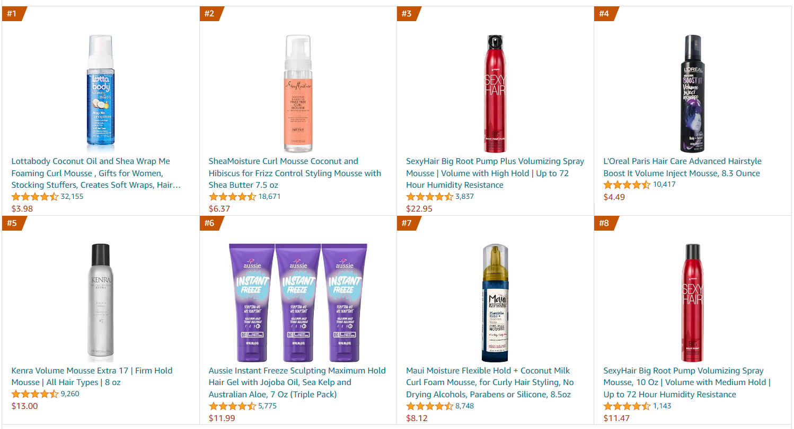
Bestseller View
Hair Mousses

Slide 4
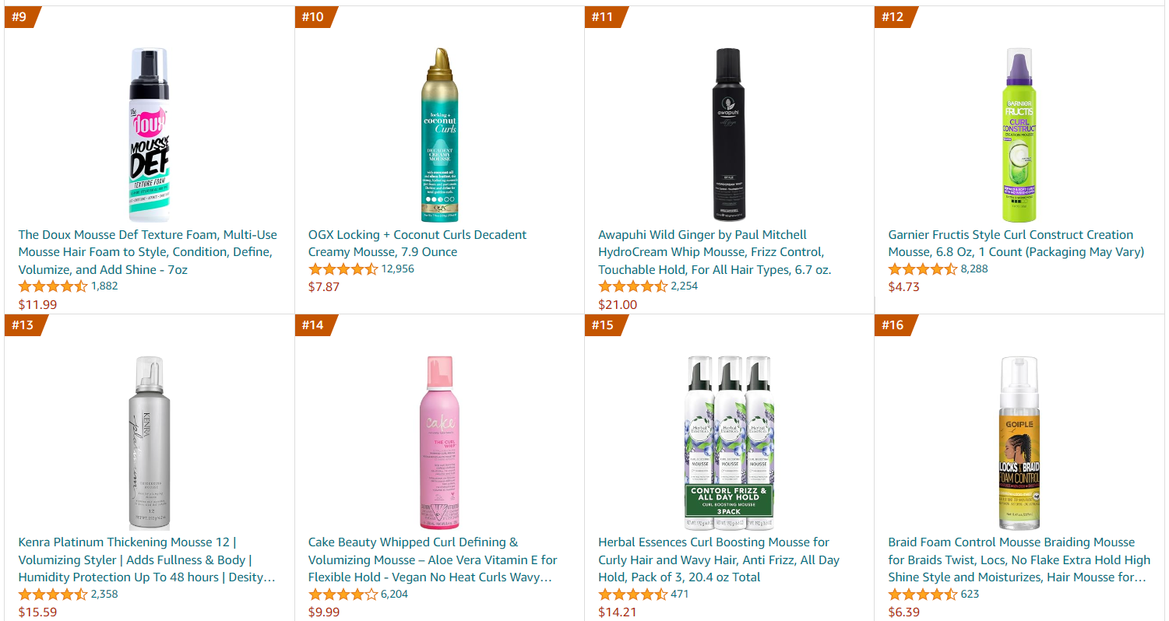
Bestseller View
Hair Mousses

Slide 5
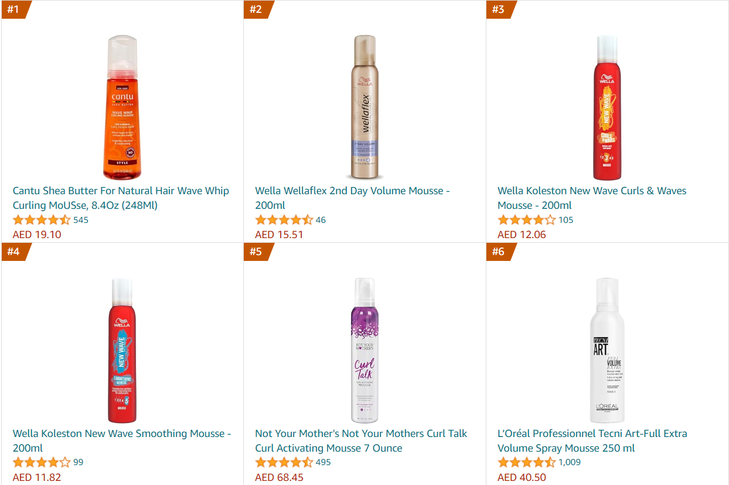
Bestseller View
Hair Mousses

Slide 6
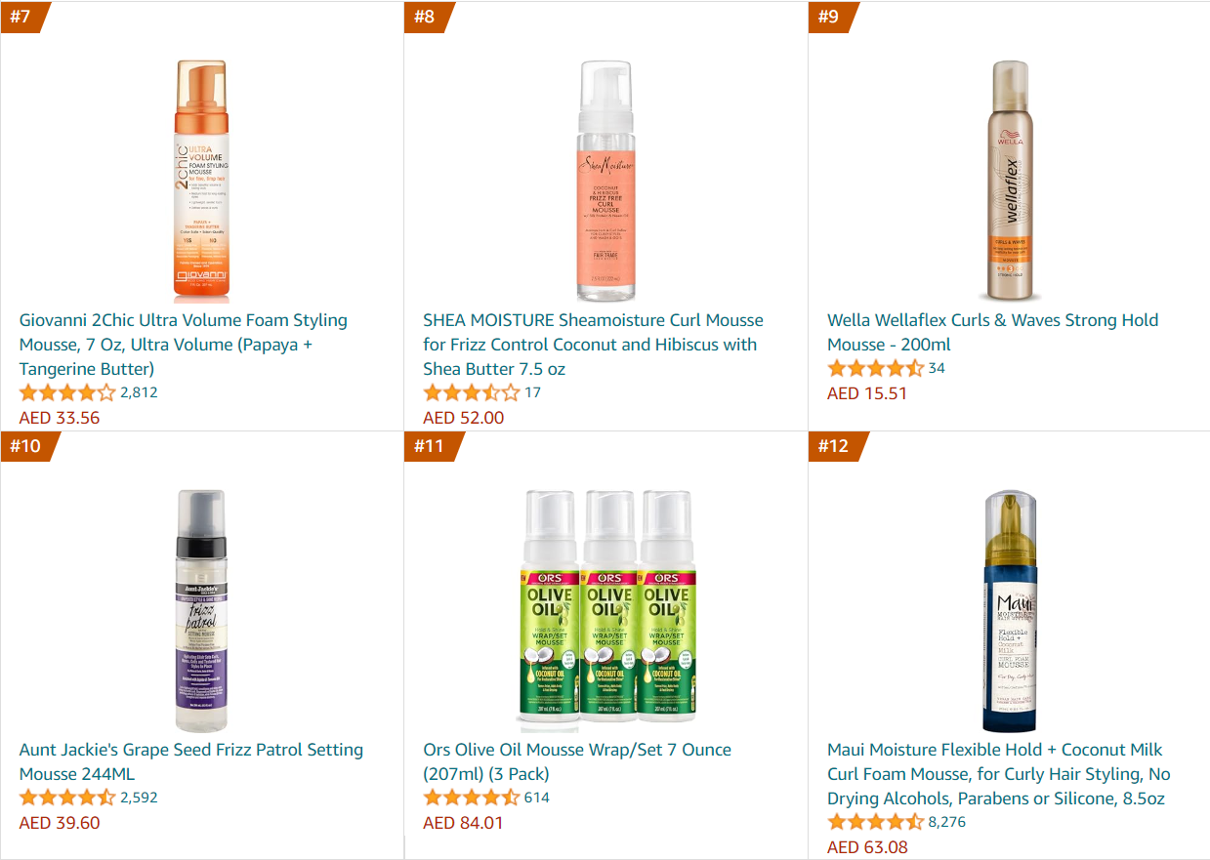
Bestseller View
Hair Mousses

Slide 7
Hair Mousses
Market Share By Brand
Note: % Represents Share of the Category by Revenue

Slide 8
Hair Mousses
No. of SKUs By Top Brands
Note: No. of SKUs represents Bestsellers
13% Share | 10% Share | 10% Share | 8% Share | 7% Share |  | 16% Share | 10% Share | 6% Share | 5% Share | 4% Share | 4% Share

Slide 9
Hair Mousses
Ingredients
Note: % Represents Share of the Category by Revenue
Note: Multiple Ingredients Present in each making the total >100%
Scientific
Natural
Scientific
Natural

Slide 10
Hair Mousses
Top Ingredient Pairs
Note: Paired ingredient is the one occurring most number of times with the ingredient in the column header
Water | Coconut | Glycerin | Panthenol | Sodium | shea butter | Argan | Dimethicone | Hibiscus | Wheat
Glycerin | Water | Water | Water | Water | Dimethicone | Water | Water | Glycerin | Water
Sodium | Glycerin | Panthenol | Glycerin | Panthenol | Coconut | Carrot | Glycerin | Carrot | Dimethicone
Panthenol | Panthenol | Ethylhexyl-glycerin | Sodium | Glycerin | Water | Cetrimonium Chloride | Sodium | Acrylate Copolymer | Cetrimonium Chloride
Dimethicone | Geranium | Sodium | Geranium | Dimethicone | Panthenol | Glycerin | Diazolidinyl Urea | shea butter | Glycerin
Carrot | Cocamidopropyl Betaine | Dimethicone | Ethylhexyl-glycerin | Cetrimonium Chloride | Glycerin | Sodium | Wheat | Coconut | Argan
Citric Acid | Aqua | Coconut | Water | Glycerin | Keratin | Olive | Cetrimonium Chloride | Neem
Aqua | Citric Acid | Hibiscus | Citric Acid | Citric Acid | Citric Acid | Coconut | Citric Acid | Coconut
Glycerin | Glycerin | Neem | Glycerin | Ethylhexylglycerin | Water | Keratin | Aqua | Hibiscus
Water | Panthenol | Citric Acid | Hibiscus | Aqua | Coconut | Citric Acid | Water | Silk
Cetrimonium Chloride | Carrot | Glycerin | Coconut | Panthenol | Olive | Neem | shea butter | Citric Acid
Hibiscus | Ethylhexylglycerin | Olive | shea butter | Water | Neem | Water | Panthenol | Olive

Slide 11
Hair Mousses
Benefits
Note: % Represents Share of the Category by Revenue
Note: Multiple Benefits Present in each making the total >100%

Slide 12
Hair Mousses
Claims
Note: % Represents Share of the Category by Revenue
Note: Multiple Claims Present in each making the total >100%

Slide 13
Hair Mousses
Ingredients X Benefits
Note: % Represents Share of the Category by Revenue
Note: Multiple Ingredients Present in each making the total >100%
Scientific
Natural

Slide 14
Hair Mousses
Ingredients X Benefits
Note: % Represents Share of the Category by Revenue
Note: Multiple Ingredients Present in each making the total >100%
Scientific
Natural

Slide 15
Hair Mousses
Ingredients X Claims
Note: % Represents Share of the Category by Revenue
Note: Multiple Ingredients Present in each making the total >100%
Scientific
Natural
Peptide is mostly in K18. No claims made by brand

Slide 16
Hair Mousses
Ingredients X Claims
Note: % Represents Share of the Category by Revenue
Note: Multiple Ingredients Present in each making the total >100%
Scientific
Natural

Slide 17
Hair Mousses
Prices By Top Brands
Price in USD
Price in AED
13% Share | 10% Share | 10% Share | 8% Share | 7% Share |  | 16% Share | 10% Share | 6% Share | 5% Share | 4% Share | 4% Share

Slide 18
Hair Mousses
MRP By Top Brands
Price in USD
Price in AED
13% Share | 10% Share | 10% Share | 8% Share | 7% Share |  | 16% Share | 10% Share | 6% Share | 5% Share | 4% Share | 4% Share

Slide 19
Hair Mousses
Weight By Top Brands
Weight in Oz
Weight in oz
13% Share | 10% Share | 10% Share | 8% Share | 7% Share |  | 16% Share | 10% Share | 6% Share | 5% Share | 4% Share | 4% Share

Slide 20
Hair Mousses
Average Discount By Top Brands
Category
Average 7.65%
Category
Average 6.28%
13% Share | 10% Share | 10% Share | 8% Share | 7% Share |  | 16% Share | 10% Share | 6% Share | 5% Share | 4% Share | 4% Share

Slide 21
Hair Mousses
Prices Per Unit Weight By Top Brands
USD / Oz
AED / ml
13% Share | 10% Share | 10% Share | 8% Share | 7% Share |  | 16% Share | 10% Share | 6% Share | 5% Share | 4% Share | 4% Share

Slide 22
Hair Mousses
Prices Per Unit Weight By Top Brands
USD / ml
USD / ml
13% Share | 10% Share | 10% Share | 8% Share | 7% Share |  | 16% Share | 10% Share | 6% Share | 5% Share | 4% Share | 4% Share

Slide 23
Hair Mousses
Top Brands - USA
Note: Top Brands by Revenue
Brand | Ingredients | Packaging | Claims | Benefits
SheaMoisture | Coconut Oil, Shea Butter, Hibiscus Flower | Pump Bottle | Residue Free, Silicone Free, Sulfate Free, Paraben Free, Mineral oil free, Cruelty Free | Curl Enhancing, Volumizing, Moisturizing, Frizz Control
Others | Bamboo, Kakadu Plum, Water, Coconut Oil | Pump Bottle, Spray Can | N/A | Frizz Control, Volumizing, Curl Enhancing, Shine, Humidity Protection
Kenra | Water, Wheat, Dimethicone, Panthenol | Spray Can | Alcohol Free, Cruelty Free | Flake Control, Frizz Control, Humidity Protection, Curl Enhancing, Heat Protection, Volumizing, Shine
Morracoil | Argan Oil, Water, Citric Acid | Pump Bottle, Spray Can | Cruelty Free, Residue Free, Paraben Free | Curl Protection, Smoothening, Frizz Control, Lifting, Volumizing, Long Lasting
Sexyhair | Dimethicone, Water, Wheat | Spray Can | Dairy Free, Cruelty Free | Hold, Heat Protection, Humidity Protection, Volumizing, Lifting, Shine

Slide 24
Hair Mousses
Top Brands - UAE
Note: Top Brands by Revenue
Brand | Ingredients | Packaging | Claims | Benefits
Wella | Citric Acid, Cetrimonium Chloride, Aqua | Pump Bottle | Paraben Free, Fragrance Free | Softness, Heat/ UV Protection, Humidity Protection, Lightweight, Frizz Control
Shea Moisture | Coconut, Neem, Citric Acid, Keratin, Olive | Jar | Paraben Free, Sulfate Free | Frizz Control, Shine, Curl Enhancing, Moisturization / Hydration
Not Your Mother’s | N/A | Jar | Alcohol Free | Hold, Shine, Humidity Protection, Frizz Control
Cantu | Shea Butter, Cetrimonium Chloride, Water | Jar | Paraben Free, Sulfate Free | Frizz Control, Lightweight, Curl Enhancing, Moisturization / Hydration
Giovanni | Aqua, Citric Acid | Fliptop Bottle | N/A | Shina, Lightweight, Curl Enhancing, Hold, Thickening/ Volumizing
Maui Moisture | Aloe Vera, Coconut, Mango, Glycerin | Jar | Paraben Free, Sulfate Free, Silicone Free, Alcohol Free, Mineral Oil Free | Softness, Frizz Control, Lightweight, Curl Enhancing, Moisturization / Hydration

Slide 25
Hair Mousses
Weight Band
Note: % Represents Share of the Category by Revenue
Band in Oz
Band in oz

Slide 26
Hair Mousses
Price Band
Note: % Represents Share of the Category by Revenue
Band in USD
Band in AED

Slide 27
Hair Mousses
MRP Band
Note: % Represents Share of the Category by Revenue
Band in USD
Band in AED

Slide 28
Hair Mousses
Discount Band
Note: % Represents Share of the Category by Revenue

Slide 29
Hair Mousses
Discount Band
Note: % Represents Share of the Category by Revenue
Note: K18 and Olaplex have been excluded

Slide 30
Hair Mousses
Price Per Weight Band
Note: % Represents Share of the Category by Revenue
Band in USD / Oz
Band in AED / ml

Slide 31
Hair Mousses
Price Per Weight Band
Note: % Represents Share of the Category by Revenue
Band in USD / ml
Band in USD / ml

